Slide 1
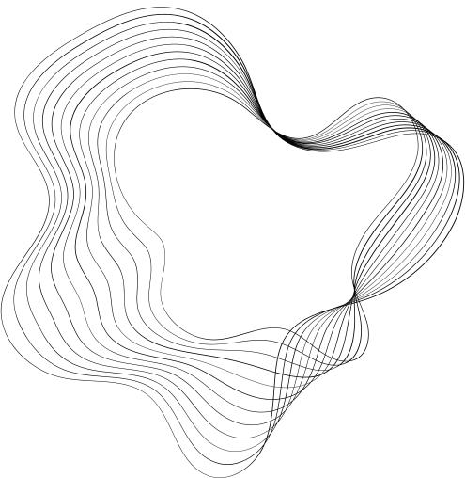


PET FOOD
E-COMMERCE PLATFORM WITH IBM CLOUD FOUNDRY

Slide 2
PHASE 3
TEAM MEMBERS:
1.SELVARASU K
2.SENTHIL NATHAN M
3.SHANMUKHAA M S
4.ALAGESAN P
5.SANTHOSHKUMAR L

Slide 3

PROJECT STATEMENT
The project is to build a PET FOOD e-commerce platform using IBM Cloud Foundry. The goal is to connect skilled artisans with a global audience, showcasing their handmade products and providing features like secure shopping carts, payment gateways, and an intuitive checkout process. This involves designing the e-commerce platform, implementing necessary features, and ensuring a seamless user experience.

Slide 4
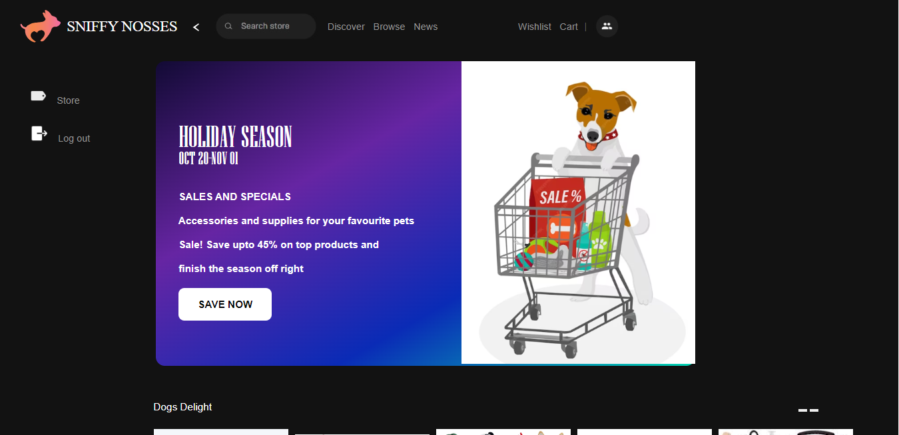

Slide 5
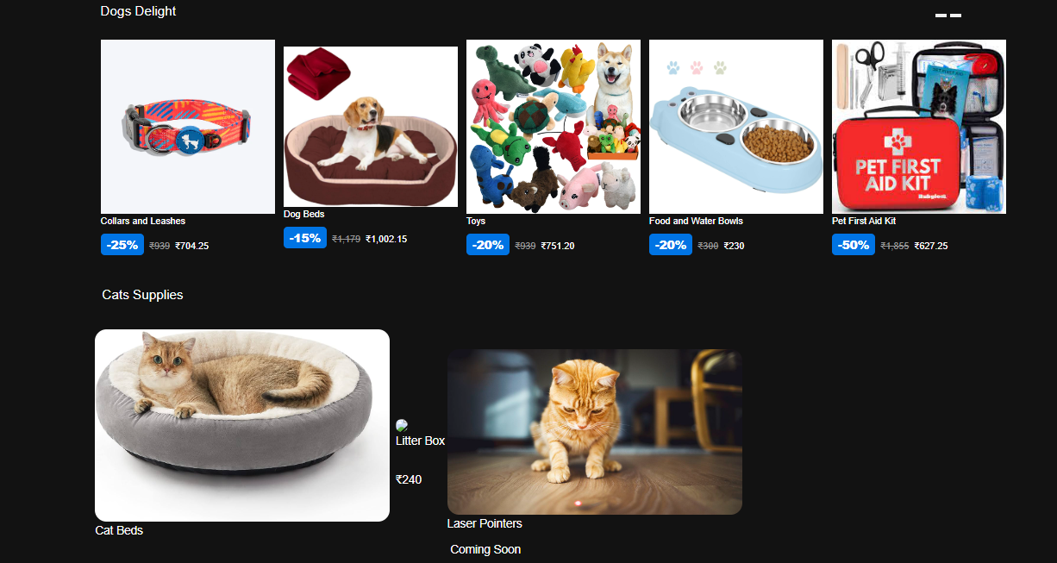

Slide 6
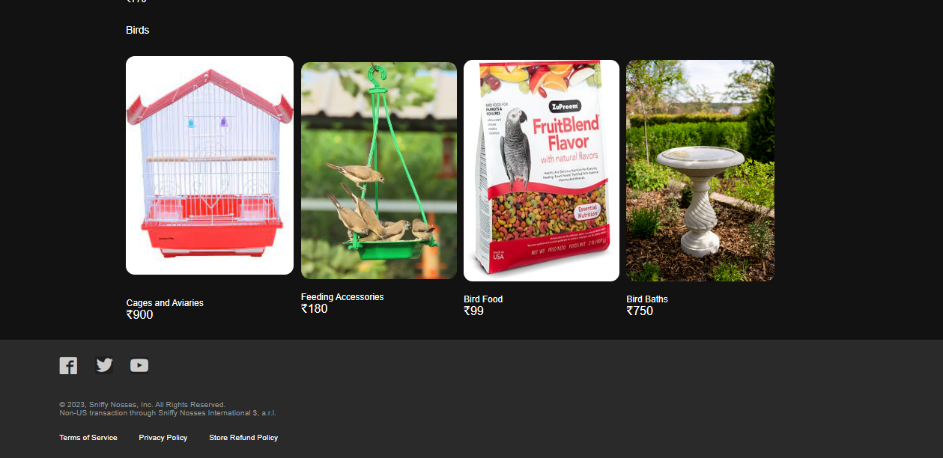

Slide 7
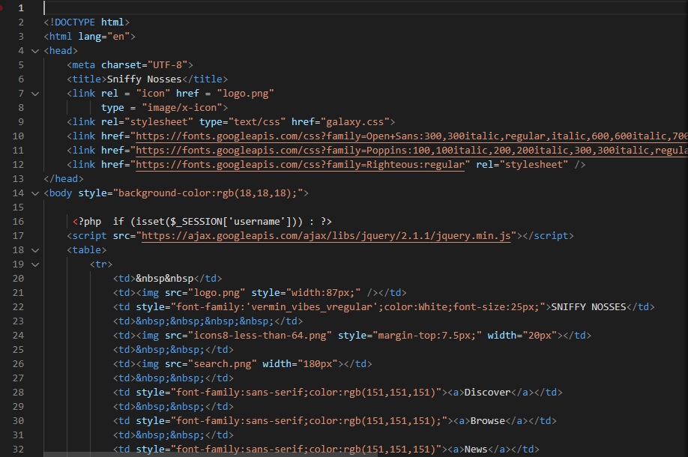
CODE:

Slide 8
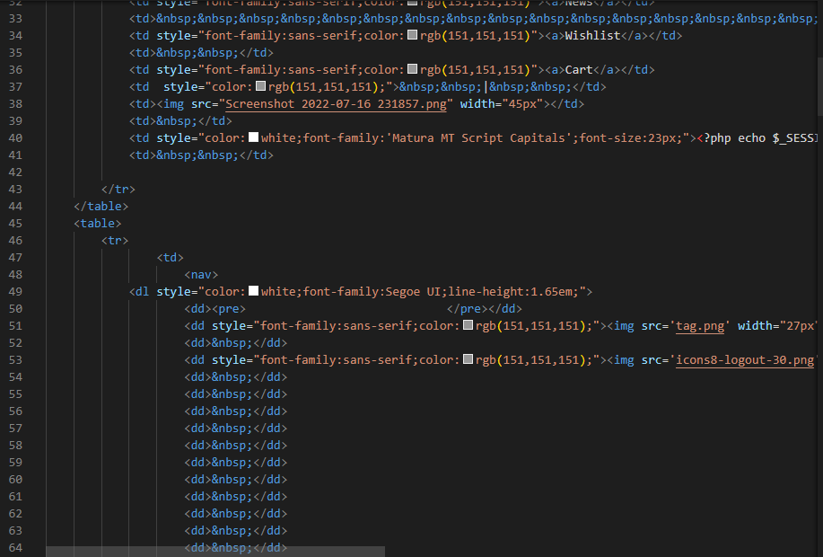
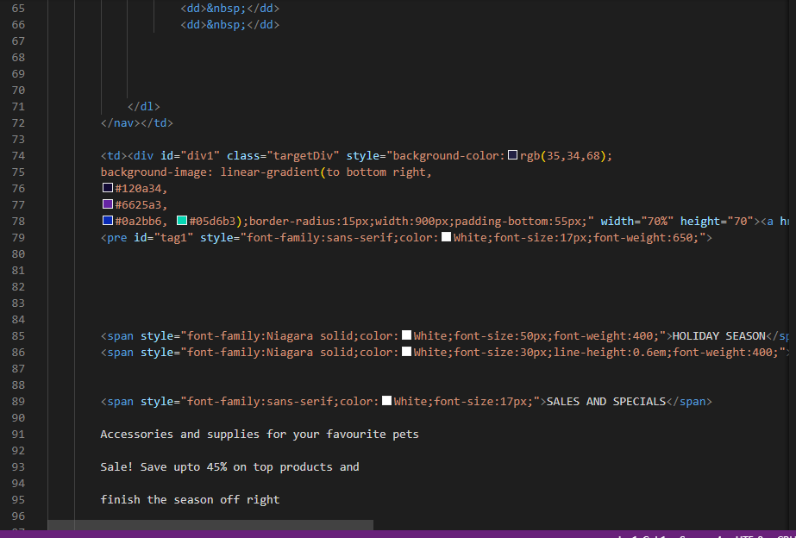

Slide 9
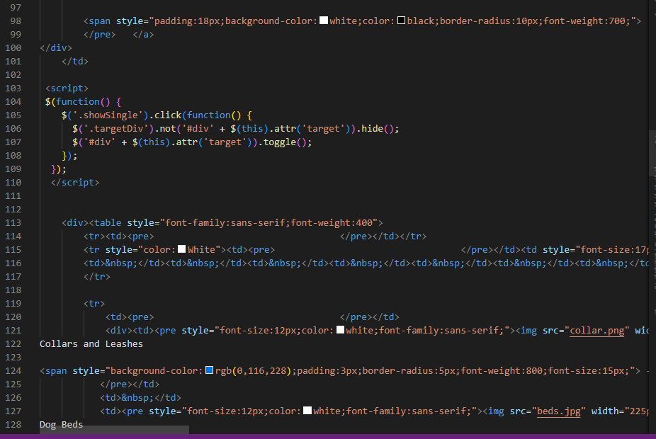
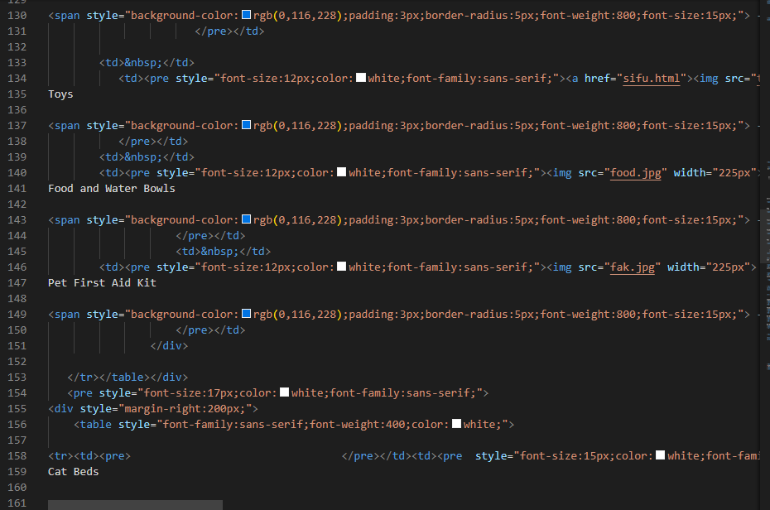

Slide 10
